Slide 1

Relief to Rowstock /R2R/RRS
AGM 1st November 2023

Slide 2
R2R Scheme Overview
Create an eastbound bus lane from Steventon lights junction towards Milton Interchange – a total distance of less than 600m and add a 3m shared path for pedestrians and cyclists also between Steventon lights and Milton Interchange.
Upgrade of Steventon lights including
  Widening to provide a segregated bus lane on the approach to the junction from the south
  Widening to provide three lanes on the approach to the junction from the north
Add new traffic lights at the junction with Trenchard Avenue and the A4130
Add new bus stop shelters and bike stands
New speed limit of 40mph along the A4130
Notes:
RRA agrees that the exit from Trenchard Avenue needs improving. What RRA is saying that this overall scheme is not the right scheme.

Slide 3
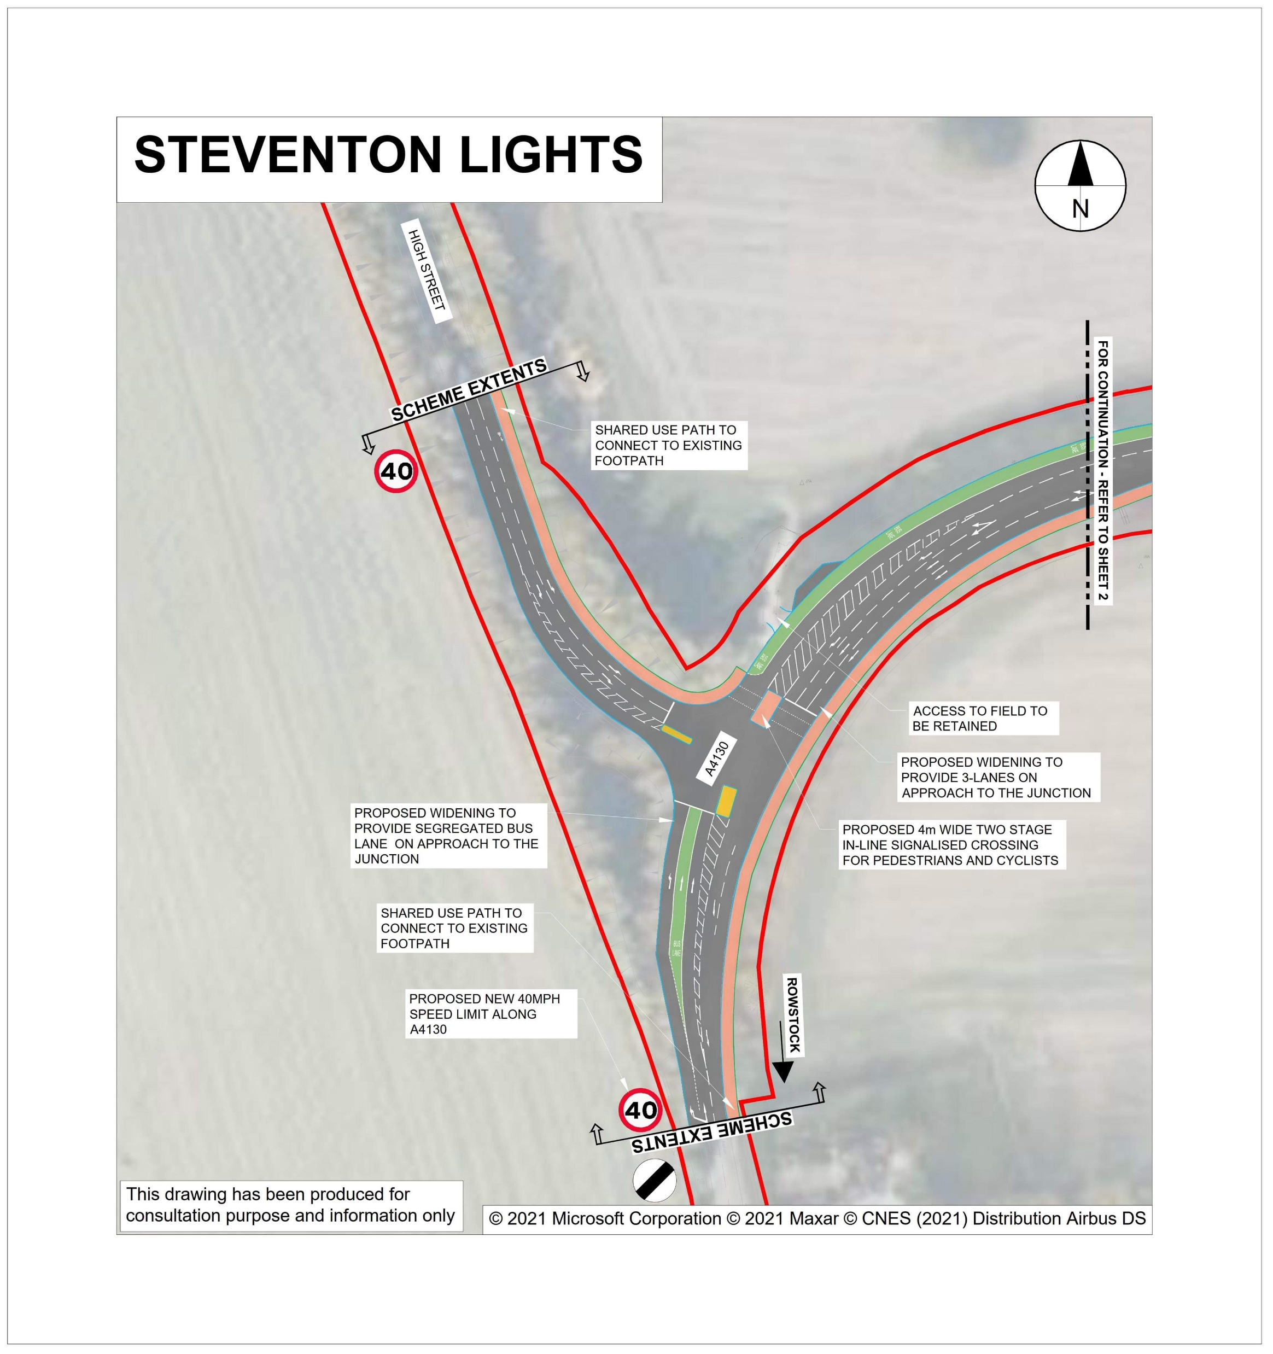

Slide 4
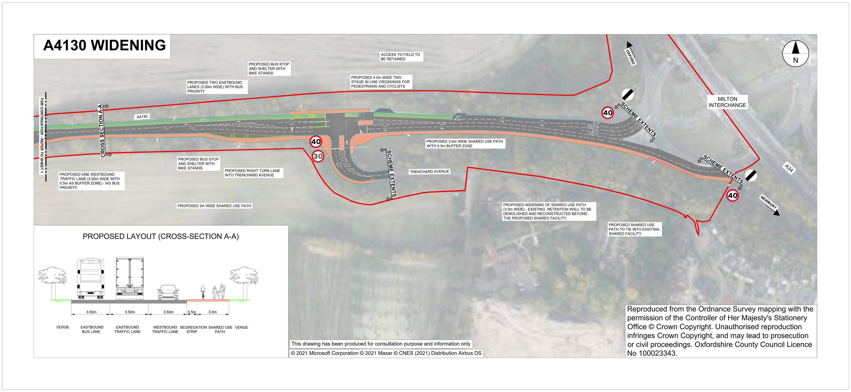

Slide 5
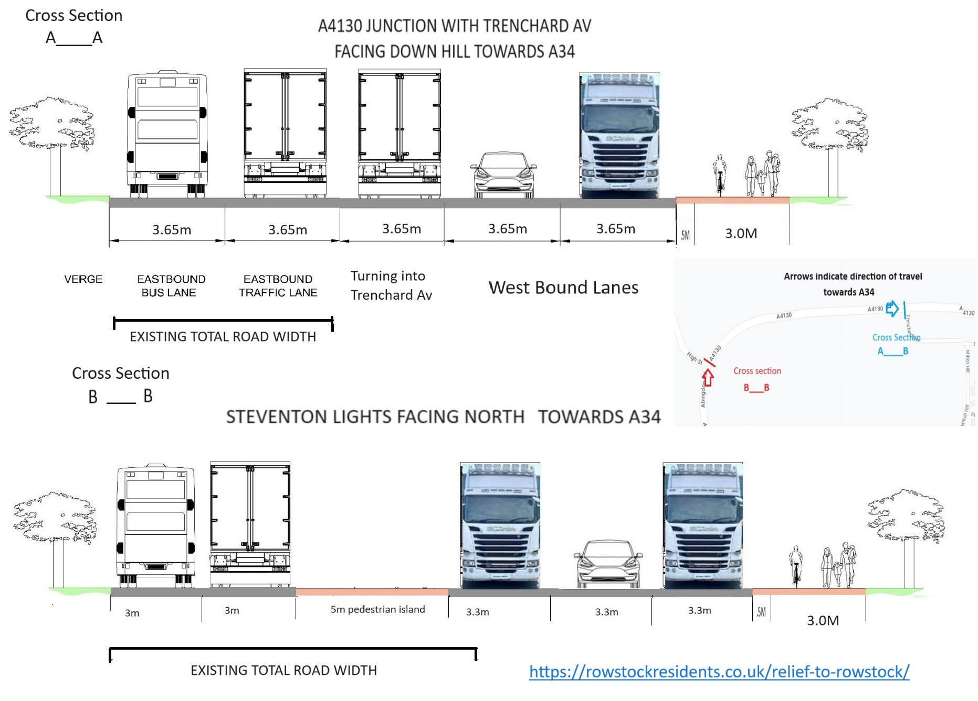

Slide 6
OCC stated objectives, webpage OCC letstalk
Support planned growth in housing and employment in the region
Reduce congestion for private vehicles.
Improve safety for all users.
Provide suitable infrastructure and encourage use of all active travel modes.
Facilitate and incentivise use of public transport as alternative to private car travel by improving bus journey time reliability.
Minimise impact on landscape and provide a betterment to the local environment.
Source – OCC ,Consultation/Engagement Report June 2023
Notes:
To support planned growth in housing and employment in the region while following the policies set out in Local Transport and Connectivity Plan (LTCP).
To reduce congestion for private vehicles.
To improve safety for all road users.
To provide suitable infrastructure and encourage use of all active travel modes.
To facilitate and incentivise the use of public transport as an alternative to private car travel by improving bus journey time reliability.
To minimise the impact on the landscape and provide a betterment to the local environment.

Slide 7
OCCs Consultants, AECOM – Project Report, January 2022
“…….the results indicate that the junction would be operating over capacity and would experience significant queues for the majority of the day.” (paragraph 6.21)
“it is not possible to gain a positive result using a reasonable cycle time….the BUS LANE option would NOT be recommended.” (paragraph 6.23)
Notes:
To be clear, the modelling carried out by AECOM showed that for the majority of the day ALL traffic would experience delays – Cars, Bicycles AND Cars and not just on the A4130 . Users of Trenchard Avenue and Steventon Hill would experience severe delays too.

Slide 8
RRAs Consultants, Motion - Project Review, June 2023
Fails to meet current design standard - UNSAFE
No interdependency between junctions
Sustainable travel is a bolt on – ‘Greenwash’
Where is active travel going to and from – integration into existing traffic system
NO Relief for Rowstock
Notes:
Motions conclusions-
“There are several aspects of the design which fails to meet the requirements of Design Manual for Roads and Bridges (DMRB) including the failure to design for the types of traffic (HGVs for example) using the route as well as failure to provide adequate visibility splays.
Provision is in place of a total of six metres for a bus lane and adjacent traffic lane leaves very little margin for error on the part of drivers. This is particularly true on bends, where additional width is typically required. No swept path analysis is provided and there is no evidence that interactions between buses and large vehicles and the associated safety implications have been considered. This will be detrimental to the operational capacity and safety of the RRS. OCC claim to have carried out a road safety audit yet have failed to provide this.
There is no assessment of how these two junctions operate together notwithstanding that the assessment work provided demonstrates that the queues and delays arising at each junction would interfere with the operation of both junctions. Neither is there an assessment of how these two junctions would operate cumulatively with the existing, adjacent A34 Milton Interchange again notwithstanding the obvious inter-dependency of these three junctions.
The assessment work therefore fails to provide a reliable indication of how the RRS will impact on the movement of traffic along the A4130 between Steventon High Street and the A34. This is a fundamental and fatal failing in the assessment work.
Turning to the sustainable travel infrastructure options considered, this appears to have been bolted on as an afterthought in an attempt to “greenwash” what is otherwise a wholly traffic based scheme. The documentation and assessment work provided describes two, standalone traffic signal junction schemes which are entirely isolated from the surrounding, existing transport environment. No consideration is given to where public transport is travelling to and from. No consideration is given to where active travel modes are travelling to and from. Neither is any consideration given to how these sustainable modes will be catered for once they have exited the RRS, which fails to provide any context for how it is intended to integrate into the existing movement environment.
As presented, in terms of sustainable travel and encouraging mode shift, the RRS appears to be wholly otiose as it neither connects to or is connected to any other sustainable travel infrastructure.
Nowhere in the documentation provided by OCC has it been possible to ascertain what the intended function of the RRS is or what outcomes are sought from the scheme. Being some 2km remote of Rowstock, it cannot possibly be that the RRS is intended to relieve Rowstock as the scheme’s name implies.”

Slide 9
RRA Actions
Motions FOI request of OCC
18th August 2023 RRA Directly Requested meeting with Sally , Richard and Gavin Belcher - OCC
17th October 2023 – RRA Barrister wrote to Martin Reeves – Chief Exec OCC
Presented to Parishes – Harwell, Steventon and Milton. Met with East Hendred PC and Sarah James – Vale DC
Partial response, then ignored
Ignored
Ignored

Slide 10
Phase 2 and 3?
Steventon Lights Junction
Featherbed Lane (North)
Featherbed Lane (South)
Rowstock Junction
The proposed A4185 Newbury/Western Link Road
The proposed A417 Wantage Road/Western Link Road
Notes:
In OCCs report, released to RRA under FOI, chapters 1,2,4,5,6,7,9 and 11 were omitted . OCC effectively redacted a total of 112 pages out of the 148 pages that made up the report.
However in Chapter 8, OCC states
“The designs for the following locations were tested as a part of the Relief to Rowstock Way scheme:
Steventon Lights Junction
Featherbed Lane (North)
Featherbed Lane (South)
Rowstock Junction
The proposed A4185 Newbury/Western Link Road
The proposed A417 Wantage Road/Western Link Road”
RRA suspect that the missing Chapters were in fact relating to the project as a whole but despite asking for the complete report, yet again, we are being kept in the dark.

Slide 11
Has this plan met OCCs objectives?
FAILED
Support planned growth in housing and employment in the region.
FAILED
Reduce congestion for private vehicles.
Improve safety for all users.
Provide suitable infrastructure and encourage use of all active travel modes.
Facilitate and incentivise use of public transport as alternative to private car travel by improving bus journey time reliability.
Minimise impact on landscape and provide a betterment to the local environment.
FAILED
FAILED
FAILED
FAILED
£10m
Notes:
The scheme is not ‘joined -up’ to planned growth in housing its associated traffic such as Valley Park, Grove and Wantage. (Objective 1- FAILED).
The provision of a single direction bus lane, the wider shared path and the increased use of signals will create increased congestion and severe delays for ALL traffic leading up Steventon Hill from Steventon and from The Packhorse to Steventon lights (OCC’s objective 2 - FAILED). OCC documents show that their own transport consultants did NOT recommend the scheme for the same reason.
There are elements of the scheme that do not meet current safety standards such as the narrow lanes impacting the ability of HGVs to turn at Steventon lights and further reduction in visibility at the bend at Steventon lights heading southbound. In addition the constant merging of 2 lanes into 1 and back into 2 again is confusing and encourages dangerous overtaking and speeding – look at the exit off Milton Interchange. (Objective 3 – FAILED)
OCCs own consultants are stating that the bus lane is not “suitable” . There has been no attempt to assess if the bus lane and cycle path will increase the number of people travelling by bus or bicycle nor consider where such journeys would be coming from or going to. (Objectives 4 and 5 – FAILED)
How will 1 year of roadworks to increase the width of the carriageway effectively making sections of 100m or less a 5 lane road, benefit the landscape and better the local environment? (Objective 6 – FAILED)
Plan to start construction in Spring 2024 and complete in Spring 2025 at a forecasted cost of £10m.
OCC is saying it will come from section 106 monies and other city growth deals and grants. Is there a contingency should costs over run? Who will pay for this? OCC say
they have to “use it or loose it”. But it can be used elsewhere – improve the path/cycle way between Steventon lights and Rowstock? This route is used by twice as many cyclists per day than the route being discussed here and yet the path is so bad you cannot walk with a buggy or child let alone cycle off of the main carriageway in safety.

Slide 12
Motions Conclusion
Standalone
No clear purpose
No clear function
No meaningful benefits
No integration
Severe impacts to detriment of ALL users
Notes:
As currently presented, Motions conclusion is that rather than a comprehensive scheme, the RRS is little more than a series of stand-alone, engineering interventions with no clear purpose, function or meaningful benefits which would be imposed on the existing transport environment with no attempt to integrate it into the existing movement framework. Indeed as currently proposed, the assessment work demonstrates that there could be severe impacts on the operation of the transport network to the detriment of all users.

Slide 13
Consultation – November 2022
‘The council fail to inform the public that their own analysis concluded that the bus lanes would result in “significant queues and delays for the majority of the day.” Indeed far from stating this, the Council appears to have claimed the polar opposite!’
‘The statements generally about time savings and reduced congestion don’t seem to align with the technical assessment work provided separately to us.’
‘Respondents are overwhelmingly clear that the scheme will not enable behaviour change or shift residents to more sustainable modes.’
‘Despite there being very many sensible comments listed, OCC has simply batted these away and effectively ignored them.’
‘In short this Consultation exercise was either incompetent , deliberately misleading or indeed both’.
Motion, August 2023
Notes:
OCC claims the scheme will “mitigate congestion at the Steventon lights junction” when OCCs own Report clearly demonstrates that with the eastbound bus lane in place, this statement is simply wrong.
When asked if the project will improve the lives of residents, 32 respondents to the online survey answered ‘No’ while only 17 answered ‘Yes’. 29 respondents said
‘Maybe’.
If the proposals would help enable behaviour change and shift residents to more sustainable forms of travel The overwhelming majority of respondents said ‘No, they will continue to use their car’.
Respondents were asked to place the five improvements the proposals AIM to deliver in order of importance from 1-5,
The five improvements respondents were asked to rank, are:
· Better safety for all road users
· Improved bus journey times and reliability to the Milton Interchange/A34
· Reduce congestion for private cars
· Better access for cycling
· Better access for walking
The improvements respondents considered the most important was better safety for all road users, with improved bus journey times and reliability to the Milton Interchange/A34 considered the next important improvement. The improvement considered least important, was better access for walking .

Slide 14
Legal Advice - Simon Bell, Barrister, Clerksroom, 17th October 2023
Local residents misled
Deeply flawed and unfair
Results cannot, and should not, be relied upon as providing support for the Scheme.
OCC has predicated the Consultation based on what it wanted to achieve, when the evidence is that a key aspect of the Council’s aspirations for the Scheme cannot be delivered.
Officers appear to be approving a Scheme the benefits of which are not supported by its own underlying evidence.
Notes:
The Barrister acting on behalf of RRA states ”In short, the RRA considers that local residents were misled as to the benefits of the scheme. It seems clear from the Note that it is impossible to implement the Scheme with the inclusion of a bus lane which appears to be a key piece of infrastructure designed to support the stated aims of the Scheme. Had members of the public been made aware of the Council’s consultants’ clear, and unambiguous, statement as to the limitations of what had been proposed, it is likely that consultation responses would have sought to address this issue. The Consultation, as run and concluded, was deeply flawed and unfair and the results cannot, and should not, be relied upon as providing support for the Scheme.
The Council should not have predicated the Consultation based on what it wanted to achieve, when the evidence appears to be clear that a key aspect of the Council’s aspirations for the Scheme cannot be delivered. Officers appear to be moving towards approving a Scheme the benefits of which are not supported by its own underlying evidence base.”

Slide 15
What next?
Meeting with PCs and RRA and OCC
RRA meeting with OCC
Need your help……

